Slide 1
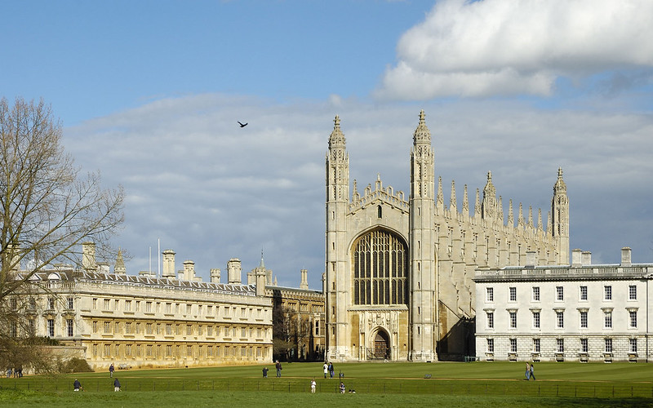
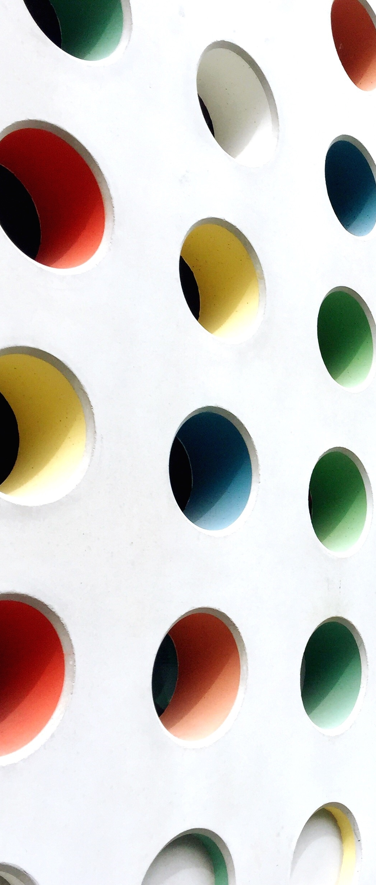
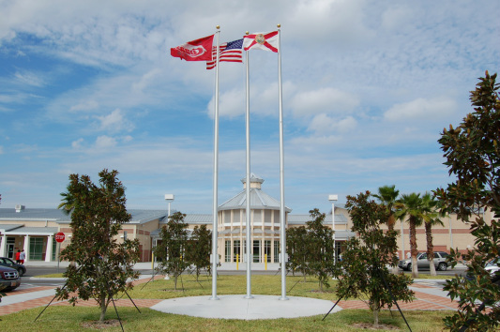






Cambridge
Susan Zona,
Cambridge AICE Coordinator
386.424.2555 ext.38723
swona@volusia.k12.fl.us
New Smyrna Beach High School
1015 Tenth Street
New Smyrna Beach, FL 32168
Mr. Timothy Merrick, Principal
Outstanding
AICE Program
2020-21
New Smyrna Beach High School
CAMBRIDGE
Jewel Johnson
AICE Counselor
386.424.2555 ext.38544
jljohnso@volusia.k12.fl.us
A.I.C.E. PROGRAM
Advanced International Certificate of Education

Slide 2
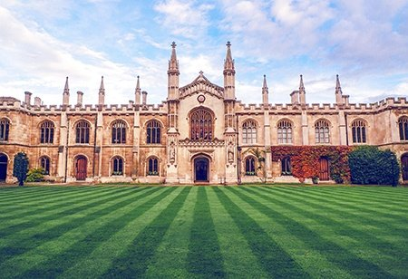
Introductions
Susan Zona,
Cambridge AICE Coordinator
386.424.2555 ext.38723
swona@volusia.k12.fl.us
New Smyrna Beach High School
1015 Tenth Street
New Smyrna Beach, FL 32168
Mr. Timothy Merrick, Principal

Slide 3
AICE Requirements
Susan Zona,
Cambridge AICE Coordinator
386.424.2555 ext.38723
swona@volusia.k12.fl.us
New Smyrna Beach High School
1015 Tenth Street
New Smyrna Beach, FL 32168
Mr. Timothy Merrick, Principal

Slide 4

Did You Know…?
What is A.I.C.E ?
Advanced International Certificate of Education
A rigorous international pre-university curriculum and examination system which emphasizes the value of broad and balanced study for academically advanced students
A rigorous curriculum that is heavily writing-based with a strong emphasis on critical thinking, analysis, and interpretation

Slide 5
What are the expectations of a student in the AICE Program?
Do
Don’t
Expect to struggle! (If you’re not challenged, you’re not growing!!)
ASK FOR HELP
Keep up with your work – Stay Organized
Ask teachers for help/Attend Office Hours/Study Groups/Tutoring
Try different solutions/study methods
Self-advocate
Dismiss a low grade – learn from your mistakes
Focus on the exam results/grade only
Engage in harmful attitudes or blaming others
Blame the “teaching style”
Give Up! Have GRIT!!

Slide 6
Did You Know…?
Why Cambridge?
Flexible curriculum – Student chooses based on interest
Future predictor of college success – Rigor, Critical thinking
GPA points – Pre-AICE classes are weighted the same as Honors classes and AICE classes are weighted the same as AP and IB
Earn college credit
Bright Futures - If the student earns the AICE diploma AND completes 100 hours of community service, they are guaranteed the top level of Bright Futures award, no matter what your SAT or ACT scores are (the minimum score is waived)

Slide 7
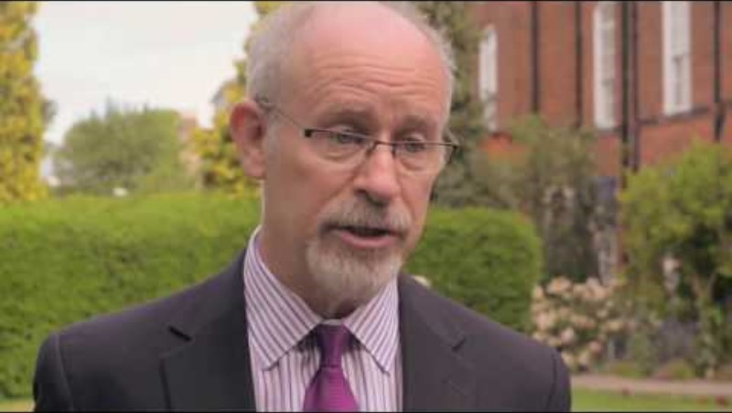
Did You Know…?
Why Cambridge?

Slide 8
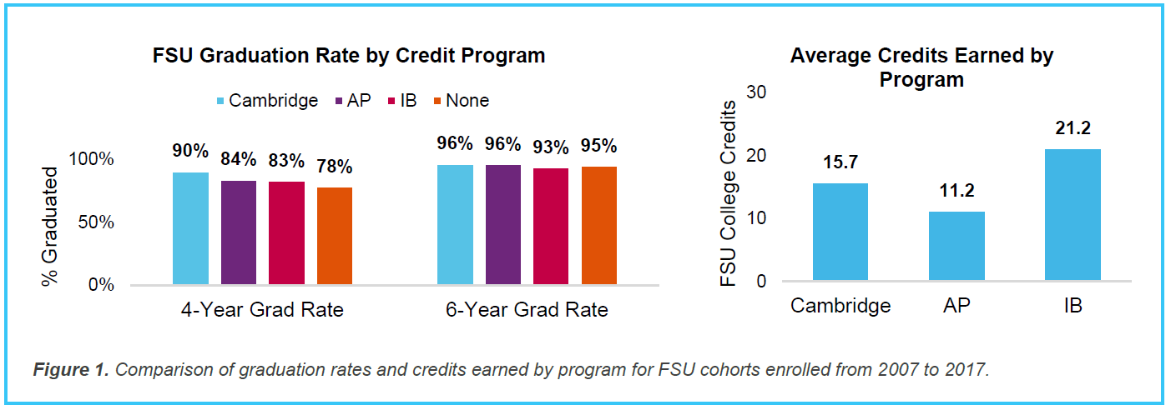
Did You Know…?
Why Cambridge – FSU Study?

Slide 9
What are the AICE Diploma Requirements?
  Pass seven (7) A/AS Level Exams
  Take a minimum of 1 exam in each group
  Complete within 25 months of the first exam
  Complete 100 hours community service
  Florida Academic Bright Futures Scholarship (FAS)
*GPA and ACT/SAT requirement waived, however still expected for college acceptance and to qualify to walk in white*

Slide 10
What are the AICE Diploma requirements?
Group 1: Science and Math
Core: Global Perspectives and Research
At least 1 point
Group 2: Languages
4 Required
+
3 Choice
=
7 points
At least 1 point
Group 3: Arts and Humanities
Required: 1 point
At least 1 point
Group 4: Interdisciplinary Skills Based Courses
Optional: Max of 2 points

Slide 11
Cambridge AICE Diploma Subject Groups and CORE
Cambridge AICE Diploma Core: AS Level Global Perspectives and Research (components 1,2 &3)
Group 1 Mathematics and Science | Group 2 Languages | Group 3 Arts and Humanities | Group 4 Interdisciplinary and skills-based subjects
Applied Information and Communication Technology Biology AS Chemistry AS Computer Science Computing Design & Technology Environmental Management (AS Level only) Further Mathematics (A Level only) Marine Science AS Mathematics Physical Education Physics Psychology | Afrikaans Language (AS Level only) Arabic Chinese Mandarin English Language AS First Language Spanish (AS Level only) French German Hindi Marathi Portuguese Spanish Tamil Telugu Urdu | Accounting Art & Design Business Studies Classical Studies Design & Textiles Divinity Economics Environmental Management (AS Level only) Food Studies (A Level only) French Literature (AS Level only) Geography Hinduism Hindi Literature (AS Level only) International History AS US History AS Islamic Studies Language & Literature in English (AS Level only) Literature in English Media Studies Music Portuguese Literature (AS Level only) Psychology Sociology Spanish Literature (AS Level only) Travel & Tourism | Thinking Skills General Paper

Slide 12
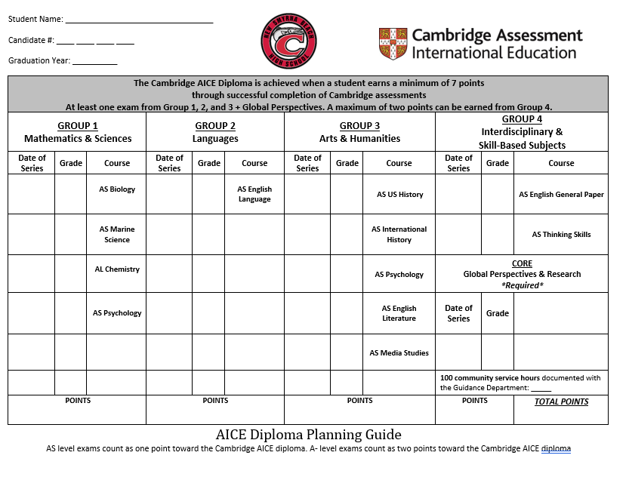
What is the AICE student tracking sheet?

Slide 13
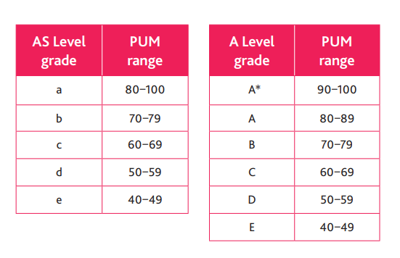
Did You Know…?
What is the difference between AS & AL?
AS Level Classes
One year
Awarded one point
Graded a (highest) to e (lowest)
AL Level Classes
Awarded two points
Graded A (highest) to E (lowest)
A “U” means Ungraded – did not earn enough points to pass the exam

Slide 14
What are the AICE Diploma Levels?
Cambridge AICE Diploma with Distinction: 360-420 points
Cambridge AICE Diploma with Merit: 250 - 359 points
Cambridge AICE Diploma at Pass level: 140 - 249 points
A Level Exam |  | AS Level Exam
Grade | Points | Grade | Points
A* | 140 | - | -
A | 120 | A | 60
B | 100 | B | 50
C | 80 | C | 40
D | 60 | D | 30
E | 40 | E | 20

Slide 15
Did You Know…?
What is the difference between a Cambridge AICE completer, AICE candidate, & AICE recipient?
Cambridge AICE curriculum completer – The student sat for all seven required classes but did not pass the necessary exams for the diploma. The student successfully completed all the high school requirements for graduation, but must meet the SAT/ACT scores to qualify for Florida Academic Bright Futures Scholarship (FAS)
Cambridge AICE candidate – Student is awaiting results of the exams and the diploma at the time of graduation
Cambridge AICE recipient – Student earned the AICE diploma prior to their senior year

Slide 16
How and when are the AICE exams given?
April/June – Some exams may occur after school ends
The June exam timetable comes out in November – Please plan vacations around tests
Test dates are NOT flexible – They are set by Cambridge University
THERE ARE NO MAKE UP DAYS!
Each exam has at least 2 papers and the student MUST sit for ALL parts to receive credit
The student MUST sit for ALL parts of the exam, or he/she will receive an obligation
Retakes are available in October upon request of the student
There is a 25-month timeframe for the AICE diploma track

Slide 17

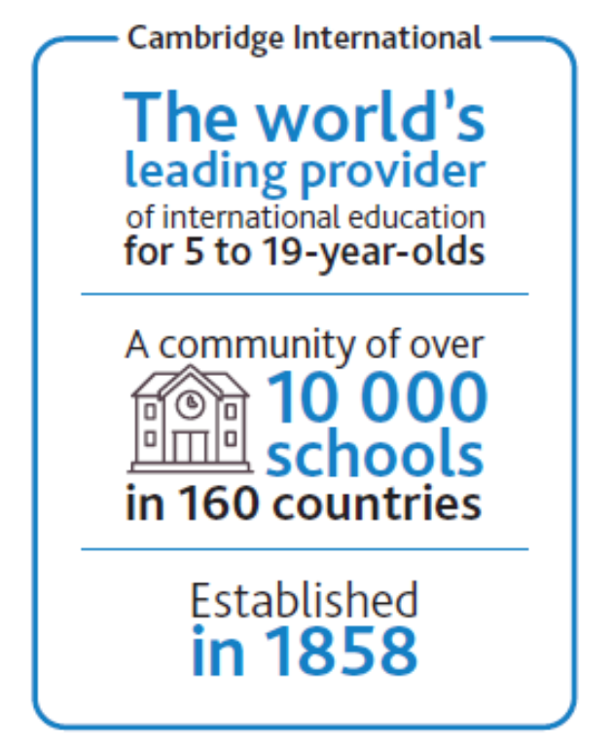
Do all colleges accept AICE credit?
More than 500 colleges and universities nationwide accept AICE credits
Each exam passed = college credit earned
All Florida colleges accept/award college credit for passing scores on AICE exams
Private and out-of-state colleges will have their own policy about credit-by-exam – CHECK!

Slide 18
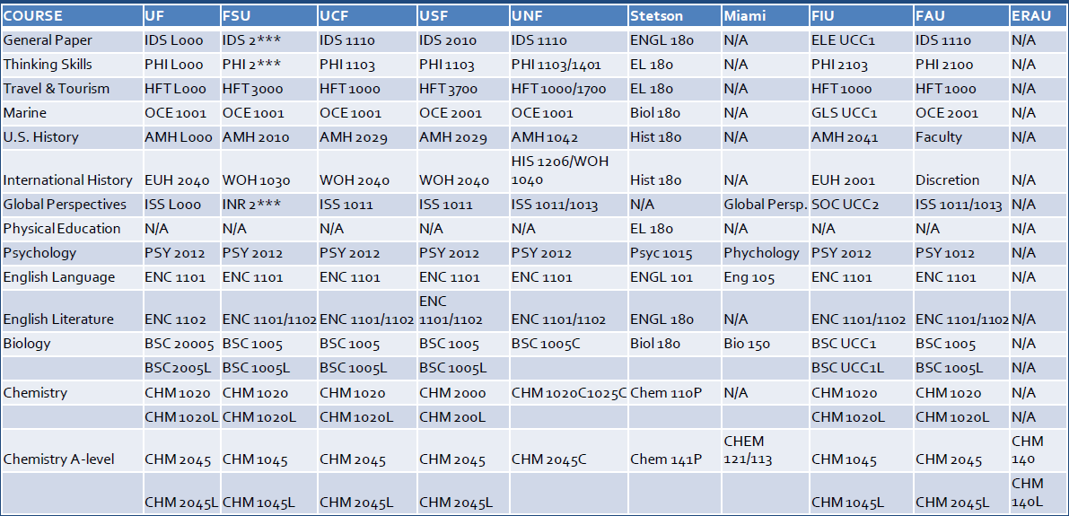

Slide 19
Communication
Susan Zona,
Cambridge AICE Coordinator
386.424.2555 ext.38723
swona@volusia.k12.fl.us
New Smyrna Beach High School
1015 Tenth Street
New Smyrna Beach, FL 32168
Mr. Timothy Merrick, Principal
Jewel Johnson
AICE Counselor
386.424.2555 ext.38544
jljohnso@volusia.k12.fl.us

Slide 20


“Be in the loop”
Email – Students check email daily
Follow us on Instagram @ nsbhs_aice
CAMBRIDGE
Notes:
Create an outline to get ready:
Introduce the era (Use a mix of media and text)
Organize your artifacts to outline what life was like during the era you are presenting
Think about using a storyboard to outline your images and ideas
Make sure you prepare a clear and well rounded presentation of all aspects of the era (People, jobs, food, transportation, etc. What else should you include so the audience feels like they have visited your era?)

Slide 21


Who is the AICE contact?
New Smyrna Beach High School
1015 Tenth Street
New Smyrna Beach, FL 32168
Mr. Timothy Merrick, Principal
Susan Zona - Cambridge AICE Coordinator
386.424.2555 ext.38544
swzona@volusia.k12.fl.us
CAMBRIDGE
Notes:
Create an outline to get ready:
Introduce the era (Use a mix of media and text)
Organize your artifacts to outline what life was like during the era you are presenting
Think about using a storyboard to outline your images and ideas
Make sure you prepare a clear and well rounded presentation of all aspects of the era (People, jobs, food, transportation, etc. What else should you include so the audience feels like they have visited your era?)

Slide 22
Questions?
Susan Zona,
Cambridge AICE Coordinator
386.424.2555 ext.38723
swona@volusia.k12.fl.us
New Smyrna Beach High School
1015 Tenth Street
New Smyrna Beach, FL 32168
Mr. Timothy Merrick, Principal
Jewel Johnson
AICE Counselor
386.424.2555 ext.38544
jljohnso@volusia.k12.fl.us

Slide 23
Thank you!
Susan Zona,
Cambridge AICE Coordinator
386.424.2555 ext.38723
swona@volusia.k12.fl.us
New Smyrna Beach High School
1015 Tenth Street
New Smyrna Beach, FL 32168
Mr. Timothy Merrick, Principal

